Slide 1


Slide Design by instagram.com/mohijeet/
Hello Baroda!!
Rivu Chakraborty

Slide 2

Let’s Talk Composing UI
Rivu Chakraborty
https://rivu.dev

Slide 3



Rivu Chakraborty
About Me
https://rivu.dev
Sr Software Engineer (Android) - BYJU’S
Instructor - Caster.io
Google Certified Associate Android Developer
Speaks on Kotlin / Android
Author - Reactive Programming in Kotlin
Author - Functional Kotlin
Author - Hands-On Data Structures and Algorithms with Kotlin

Slide 4

Big Shout Out
@intelligibabble
http://intelligiblebabble.com/
Leland Richardson
Notes:
Compose team member @ Google
Learnt a lot about Compose from him.

Slide 5
This Talk Covers
Why should we care
@rivuchakraborty
https://rivu.dev

Slide 6
This Talk Covers
Why should we care
How to Use Jetpack Compose
@rivuchakraborty
https://rivu.dev

Slide 7
This Talk Covers
Why should we care
How to Use Jetpack Compose
How Compose Works
@rivuchakraborty
https://rivu.dev

Slide 8
This Talk Covers
Why should we care
How to Use Jetpack Compose
How Compose Works
How to manage States with Compose
@rivuchakraborty
https://rivu.dev

Slide 9
Why Should We Care
@rivuchakraborty
https://rivu.dev

Slide 10

Why Should We Care
@rivuchakraborty
https://rivu.dev
Notes:
SwiftUI

Slide 11

Why Should We Care
@rivuchakraborty
https://rivu.dev
Notes:
React

Slide 12

Why Should We Care
@rivuchakraborty
https://rivu.dev
Notes:
Vue.js

Slide 13

Why Should We Care
@rivuchakraborty
https://rivu.dev
Notes:
Litho

Slide 14

Why Should We Care
@rivuchakraborty
https://rivu.dev
Notes:
Flutter

Slide 15

Why Should We Care
@rivuchakraborty
https://rivu.dev
Notes:
Jetpack Compose
A bit late in the party

Slide 16
Why Should We Care
Functional
Declarative
Reactive
UI
@rivuchakraborty
https://rivu.dev
Notes:
Can’t say about others, but Compose is also built around Reactive Principles, we will soon see how

Slide 17
Why Should We Care
UI
Declarative
Functional
Reactive
Functional Declarative UI is on rise to become The Way of doing UI
@rivuchakraborty
https://rivu.dev

Slide 18
Why Should We Care
Benefits
Separation of Concerns
@rivuchakraborty
https://rivu.dev
Notes:
Benefits - separation of concerns, Functional, developers language / way of saying things thus increased speed of development, seemless interactive between developers and designers, DSL

Slide 19
Why Should We Care
Benefits
Separation of Concerns
Declarative + Functional / Reactive
@rivuchakraborty
https://rivu.dev
Notes:
Fully declarative for defining UI components, including drawing and creating custom layouts. Simply describe your UI as a set of composable functions, and the framework handles UI optimizations under the hood and automatic updates to the view hierarchy.
Also, Functional constraints make it more ideomatic
Compose is also Reactive by nature, how? We will see later in this session

Slide 20
Why Should We Care
Benefits
Separation of Concerns
Declarative + Functional / Reactive
DSL
@rivuchakraborty
https://rivu.dev
Notes:
All the benifits of a DSL

Slide 21
Why Should We Care
Benefits
Separation of Concerns
Declarative + Functional / Reactive
DSL
Developer Friendly
@rivuchakraborty
https://rivu.dev
Notes:
Benefits - separation of concerns, Functional, developers language / way of saying things thus increased speed of development, seemless interactive between developers and designers, DSL

Slide 22
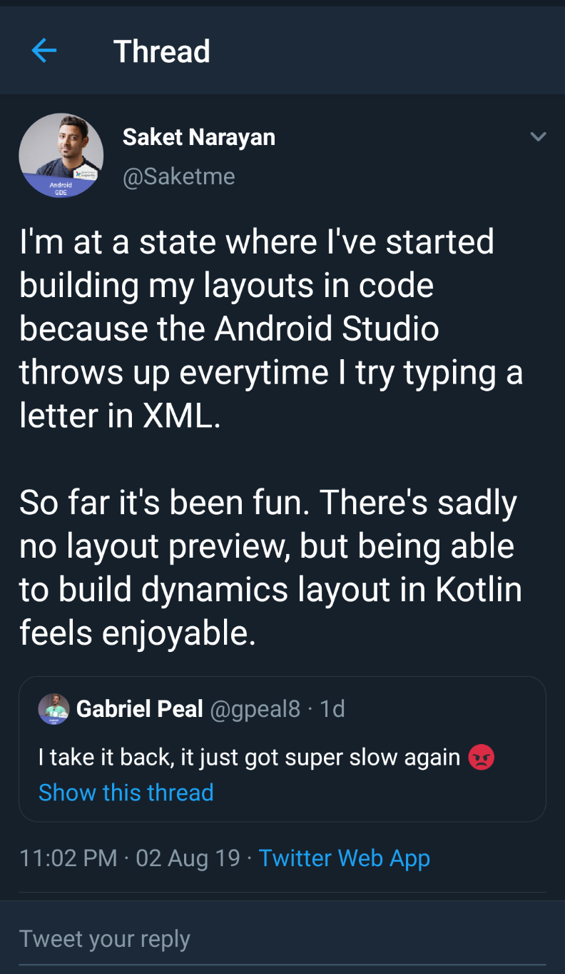
Why Should We Care
@rivuchakraborty
https://rivu.dev
Notes:
Jetpack Compose dramatically reduces memory usage, and increases performance of the app, we will see how, later in this slide

Slide 23
Why Should We Care
Benefits
Separation of Concerns
Functional / Reactive
DSL
Developer Friendly
Designer Friendly
Flattened UI
@rivuchakraborty
https://rivu.dev
Notes:
Benefits - separation of concerns, Functional, developers language / way of saying things thus increased speed of development, seemless interactive between developers and designers, DSL

Slide 24
Why Should We Care
Benefits
Separation of Concerns
Functional / Reactive
DSL
Developer Friendly
Designer Friendly
Flattened UI
Less Compile Time Overhead
@rivuchakraborty
https://rivu.dev
Notes:
As the compiler won’t need to parse lots of huge XML files

Slide 25
Why Should We Care
Benefits
Separation of Concerns
Functional / Reactive
DSL
Developer Friendly
Designer Friendly
Flattened UI
Less Compile Time Overhead
Better Performance, Less Memory Wastage
@rivuchakraborty
https://rivu.dev
Notes:
Jetpack Compose dramatically reduces memory usage, and increases performance of the app, we will see how, later in this slide

Slide 26
Why Should We Care
Benefits
Separation of Concerns
Functional / Reactive
DSL
Developer Friendly
Designer Friendly
Flattened UI
Less Compile Time Overhead
Better Performance, Less Memory Wastage
Easier State Management
@rivuchakraborty
https://rivu.dev
Notes:
Jetpack Compose dramatically reduces memory usage, and increases performance of the app, we will see how, later in this slide

Slide 27
How to use Jetpack Compose

Slide 28
How to use
Jetpack Compose
Everything is `fun`
And Lambda
Notes:
We will just write & compose simple “PURE” functions

Slide 29
How to use Jetpack Compose
@Composable
fun CustomText(text: String) {
Text(text = text, textAlign = TextAlign.Center)
}
@rivuchakraborty
https://rivu.dev
Notes:
So, this is how a composable function looks like

Slide 30
How to use Jetpack Compose
@Composable
@rivuchakraborty
https://rivu.dev
Notes:
suspended
* Annotating a function or expression with [Composable] changes the type of that function or
* expression. For example, [Composable] functions can only ever be called from within another
* [Composable] function. A useful mental model for [Composable] functions is that an implicit
* "composable context" is passed into a [Composable] function, and is done so implicitly when it
* is called from within another [Composable] function. This "context" can be used to store
* information from previous executions of the function that happened at the same logical point of
* the tree.

Slide 31
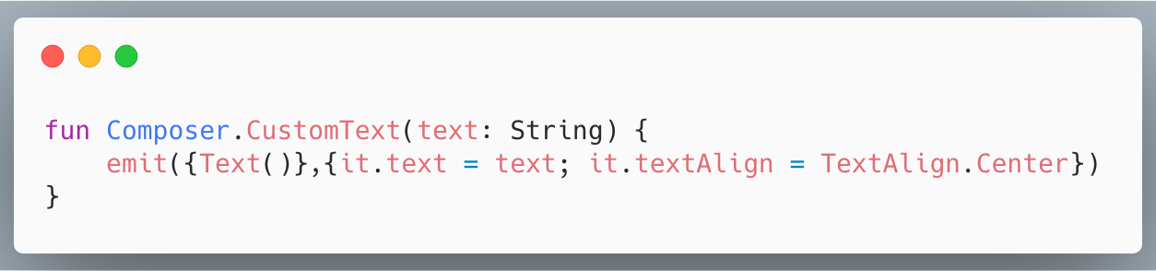
How to use Jetpack Compose
@rivuchakraborty
https://rivu.dev
Notes:
This is what @Composable transforms a Composable function to

Slide 32

How to use Jetpack Compose
Let’s build a simple App
@rivuchakraborty
https://rivu.dev
Notes:
So, let’s make this counter App, to actually understand how to use Jetpack Compose

Slide 33
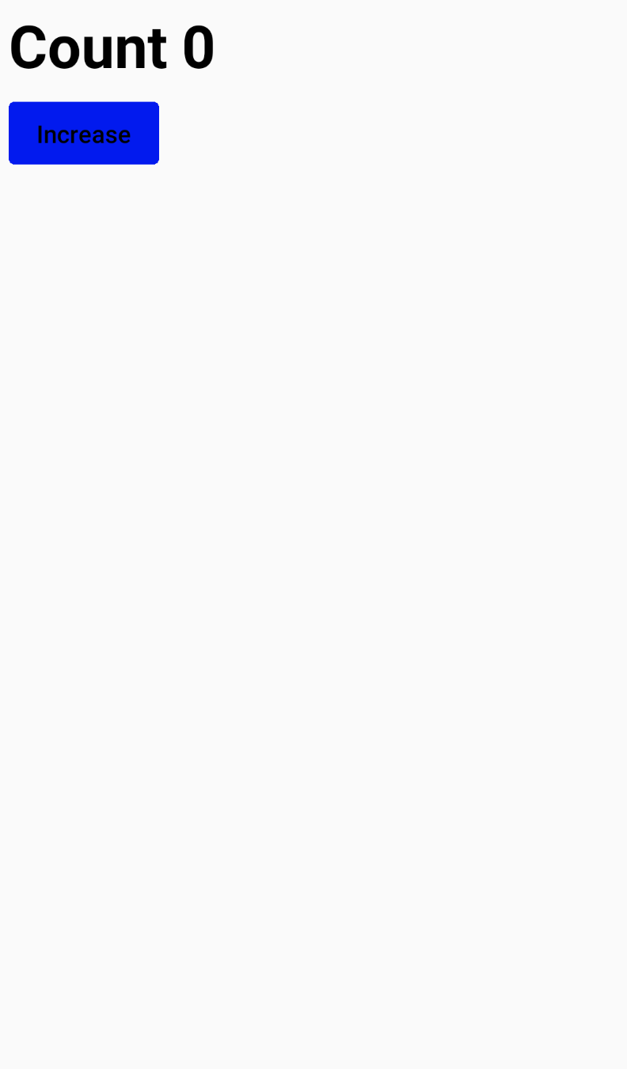
How to use Jetpack Compose
@rivuchakraborty
https://rivu.dev
Notes:
When user clicks on Increase the count should increment by 1
Jetpack Compose is still in pre-alpha, thus there might be some frustrating issues you face.
Such as changing the background color of a button while using a custom theme can be very challenging

Slide 34
How to use Jetpack Compose
setContent {
CraneWrapper {
CustomTheme {
Counter()
}
}
}
@rivuchakraborty
https://rivu.dev
Notes:
This is what the code looks like in Activity
Instead of setContentView(R.layout.layoutid), we will use something like this
Now, let’s brak this down to understand each of the lines here

Slide 35

How to use Jetpack Compose
CraneWrapper: Needed to buld the Foundation
Might be renamed/removed later or get invoked by the framework itself inside `setContent()`
@rivuchakraborty
https://rivu.dev
Notes:
Just like a JCB crane is needed for preparing the foundation of a Building Strcuture ...

Slide 36
How to use Jetpack Compose
MaterialTheme / CustomTheme: Every Root Layout (Anything inside CraneWrapper), should have a Theme
setContent {
CraneWrapper {
CustomTheme {
Counter()
}
}
}
@rivuchakraborty
https://rivu.dev

Slide 37
How to use Jetpack Compose
@Composable
fun CustomTheme(children: @Composable() () -> Unit) {
MaterialTheme(colors=myColorList, typography = myTextStyles) {
CurrentTextStyleProvider(defaultTextStyle) {
children()
}
}
}
@rivuchakraborty
https://rivu.dev

Slide 38
How to use Jetpack Compose
setContent {
CraneWrapper {
CustomTheme {
Counter()
}
}
}
@rivuchakraborty
https://rivu.dev
Notes:
Now, we know, what CraneWrapper and CustomTheme does, let us now inspect the Counter function

Slide 39
How to use Jetpack Compose
@Composable
fun Counter() {
Text(
style = +themeTextStyle { h4 },
text = "Count 0"
)
Button(
text = "Increase",
shape = CircleBorder(),
onClick = {
//Counter Increment Logic
}
)
}
@rivuchakraborty
https://rivu.dev
Notes:
So, this is the Counter Function
We called the Text Function and then the Button Function

Slide 40
How to use Jetpack Compose
@Composable
fun Counter() {
Text(
style = +themeTextStyle { h4 },
text = "Count 0"
)
Button(
text = “Increase”,
shape = CircleBorder(),
onClick = {
//Counter Increment Logic
}
)
}
@rivuchakraborty
https://rivu.dev
Notes:
So, this is the Counter Function
We called the Text Function and then the Button Function

Slide 41
How to use Jetpack Compose
@Composable
fun Counter() {
Text(
style = +themeTextStyle { h4 },
text = "Count 0"
)
Button(
text = "Increase",
shape = CircleBorder(),
onClick = {
//Counter Increment Logic
}
)
}
@rivuchakraborty
https://rivu.dev
Notes:
So, this is the Counter Function
We called the Text Function and then the Button Function

Slide 42
How to use Jetpack Compose
@Composable
fun Counter() {
Text(
style = +themeTextStyle { h4 },
text = "Count 0"
)
Button(
text = "Increase",
shape = CircleBorder(),
onClick = {
//Counter Increment Logic
}
)
}
@rivuchakraborty
https://rivu.dev
Notes:
So, this is the Counter Function
We called the Text Function and then the Button Function

Slide 43
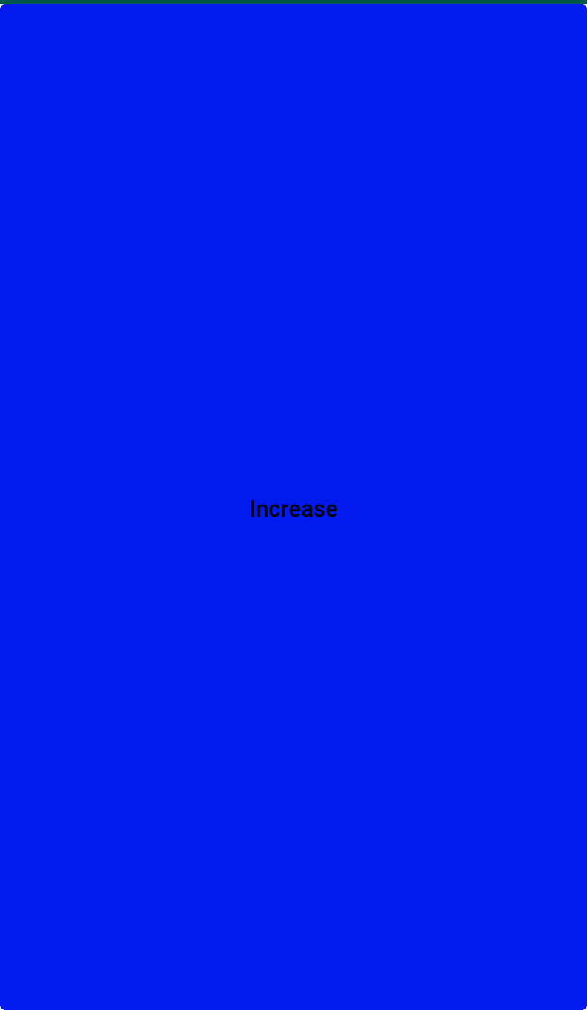
How to use Jetpack Compose
@rivuchakraborty
https://rivu.dev
Notes:
And this is the result of our Counter Function, messed up right?
Compose works pretty like FrameLayout / RelativeLayout, just the difference is that height/width defaults to Match Parent or similar

Slide 44
How to use Jetpack Compose
@Composable
fun Counter() {
Column {
Row {
Padding(padding = 5.dp) {
Text(
style = +themeTextStyle { h4 },
text = "Count 0"
)
}
}
Row {
Padding(padding = 5.dp) {
Button(
text = "Increase",
onClick = {
//Counter Increment Logic
}
)
}
}
}
}
@rivuchakraborty
https://rivu.dev
Notes:
So, that’s how the corrected version of the Counter function looks like, we use Columns and Rows and Padding. Don’t worry, even I can’t read, I’ve closer look in next slides

Slide 45
How to use Jetpack Compose
@Composable
fun Counter() {
Column {
Row {
Padding(padding = 5.dp) {
Text(
style = +themeTextStyle { h4 },
text = "Count 0"
)
}
}
Row {
Padding(padding = 5.dp) {
Button(
text = "Increase",
onClick = {
//Counter Increment Logic
}
)
}
}
}
}
@rivuchakraborty
https://rivu.dev
Notes:
So, that’s how the corrected version of the Counter function looks like, we use Columns and Rows and Padding. Don’t worry, even I can’t read, I’ve closer look in next slides

Slide 46
@Composable
fun Counter() {
Column {
Row {
Padding(padding = 5.dp) {
Text(
style = +themeTextStyle { h4 },
text = "Count 0"
)
}
}
Row {
Padding(padding = 5.dp) {
Button(
text = "Increase",
onClick = {
//Counter Increment Logic
}
)
}
}
}
}
How to use Jetpack Compose
@rivuchakraborty
https://rivu.dev
Notes:
So, that’s how the corrected version of the Counter function looks like, we use Columns and Rows and Padding. Don’t worry, even I can’t read, I’ve closer look in next slides

Slide 47
How to use Jetpack Compose
@rivuchakraborty
https://rivu.dev
Notes:
So the UI part is done

Slide 48
How to use Jetpack Compose
Let’s write the logic
for Counter
@rivuchakraborty
https://rivu.dev

Slide 49
How to use Jetpack Compose
@Composable
fun Counter() {
val countState = +state { 0 }
Column {
Row {
Padding(padding = 5.dp) {
Text(
style = +themeTextStyle { h4 },
text = "Count ${countState.value}"
)
}
}
Row {
Padding(padding = 5.dp) {
Button(
text = "Increase",
onClick = {
countState.value++
}
)
}
}
}
}
@rivuchakraborty
https://rivu.dev
Notes:
So, we have a state variable.
The countState is a val, that means countState can’t change. But the +state is a effect, it transforms the value inside curly braces to a state.
Any function / group dependant on a State, get’s a recompose whenever the value of a state changes.
To increment the counter, we just need to call countState.value++, thus the value gets incremented, and the text will also get updated
Talk about what is state, recompose, and give a little hint on how it works And it’s done

Slide 50
How to use Jetpack Compose
@Composable
fun Counter() {
val countState = +state { 0 }
Column {
Row {
Padding(padding = 5.dp) {
Text(
style = +themeTextStyle { h4 },
text = "Count ${countState.value}"
)
}
}
Row {
Padding(padding = 5.dp) {
Button(
text = "Increase",
shape = RoundedRectangleBorder(borderRadius = BorderRadius.circular(10f)),
onClick = {
countState.value++
}
)
}
}
}
}
@rivuchakraborty
https://rivu.dev
Notes:
So, we have a state variable.
The countState is a val, that means countState can’t change. But the +state is a effect, it transforms the value inside curly braces to a state.
Any function / group dependant on a State, get’s a recompose whenever the value of a state changes.
To increment the counter, we just need to call countState.value++, thus the value gets incremented, and the text will also get updated
Talk about what is state, recompose, and give a little hint on how it works And it’s done

Slide 51
@Composable
fun Counter() {
val countState = +state { 0 }
Column {
Row {
Padding(padding = 5.dp) {
Text(
style = +themeTextStyle { h4 },
text = "Count ${countState.value}"
)
}
}
Row {
Padding(padding = 5.dp) {
Button(
text = "Increase",
onClick = {
countState.value++
}
)
}
}
}
}
How to use Jetpack Compose
@rivuchakraborty
https://rivu.dev
Notes:
So, we have a state variable.
The countState is a val, that means countState can’t change. But the +state is a effect, it transforms the value inside curly braces to a state.
Any function / group dependant on a State, get’s a recompose whenever the value of a state changes.
To increment the counter, we just need to call countState.value++, thus the value gets incremented, and the text will also get updated
Talk about what is state, recompose, and give a little hint on how it works And it’s done

Slide 52
How to use Jetpack Compose
@rivuchakraborty
https://rivu.dev
Notes:
So, the whole counter app is done. We learnt how to use Compose, now lets focus on How Compose works

Slide 53

How Compose Works

Slide 54

How Compose Works
Gap Buffer
@rivuchakraborty
https://rivu.dev
Notes:
Gap Buffers are commonly known as efficient text buffers inside various text editors

Slide 55
How Compose Works
Gap Buffer
Item 1 | Item 2 | Item 3 | Empty | Empty | Empty | Empty
@rivuchakraborty
https://rivu.dev
Notes:
Gap buffer represents a flattened tree of objects, backed by a simple, flat contiguous array, of size larger than the tree itself. Inserting an object into the Gap Buffer (just like an usual array) is cheap, constant time operation, just insert an item and increment the index
Inserting in left of Gap Buffer is still O(1), unlike usual Array

Slide 56
How Compose Works
Gap Buffer
Slot Table
@rivuchakraborty
https://rivu.dev
Notes:
Compose uses the Gap Buffer in a slightly different way, and call it Slot Table, but core principles and tradeoffs are same.
The arrow on the top represents current index, which points the index in the array where the current operation is being conducted.

Slide 57
How Compose Works
Slot Table
Current Index
Item 1 | Item 2 | Item 3 | Empty | Empty | Empty | Empty
@rivuchakraborty
https://rivu.dev
Notes:
The arrow on the top represents current index, which points the index in the array where the current operation is being conducted.

Slide 58
How Compose Works
Slot Table
Current Index
Item 1 | Item 2 | Item 3 | Item 4 | Empty | Empty | Empty
@rivuchakraborty
https://rivu.dev
Notes:
Inserting an object into the Gap Buffer (just like an usual array) is cheap, constant time operation, just insert an item and increment the index

Slide 59
How Compose Works
@Composable
fun Counter2() {
val countState = +state { 0 }
Text(
style = +themeTextStyle { h4 },
text = "Count ${countState.value}"
)
Button(
text = "Increase",
onClick = {
countState.value++
}
)
}
@rivuchakraborty
https://rivu.dev
Notes:
So, let’s see how our Counter Composable would be rendered

Slide 60
How Compose Works
@Composable
fun Counter2() {
val countState = +state { 0 }
Text(
style = +themeTextStyle { h4 },
text = "Count ${countState.value}"
)
Button(
text = "Increase",
onClick = {
countState.value++
}
)
}
Group
Empty
Empty
Empty
Empty
Empty
Empty
@rivuchakraborty
https://rivu.dev

Slide 61
How Compose Works
@Composable
fun Counter2() {
val countState = +state { 0 }
Text(
style = +themeTextStyle { h4 },
text = "Count ${countState.value}"
)
Button(
text = "Increase",
onClick = {
countState.value++
}
)
}
Group
State(0)
Empty
Empty
Empty
Empty
Empty
@rivuchakraborty
https://rivu.dev

Slide 62
How Compose Works
@Composable
fun Counter2() {
val countState = +state { 0 }
Text(
style = +themeTextStyle { h4 },
text = "Count ${countState.value}"
)
Button(
text = "Increase",
onClick = {
countState.value++
}
)
}
Group
State(0)
Group
Empty
Empty
Empty
Empty
@rivuchakraborty
https://rivu.dev

Slide 63
How Compose Works
@Composable
fun Counter2() {
val countState = +state { 0 }
Text(
style = +themeTextStyle { h4 },
text = "Count ${countState.value}"
)
Button(
text = "Increase",
onClick = {
countState.value++
}
)
}
Group
State(0)
Group
“Count 0”
Empty
Empty
Empty
@rivuchakraborty
https://rivu.dev

Slide 64
How Compose Works
@Composable
fun Counter2() {
val countState = +state { 0 }
Text(
style = +themeTextStyle { h4 },
text = "Count ${countState.value}"
)
Button(
text = "Increase",
onClick = {
countState.value++
}
)
}
Group
State(0)
Group
“Count 0”
Group
Empty
Empty
@rivuchakraborty
https://rivu.dev

Slide 65
How Compose Works
@Composable
fun Counter2() {
val countState = +state { 0 }
Text(
style = +themeTextStyle { h4 },
text = "Count ${countState.value}"
)
Button(
text = "Increase",
onClick = {
countState.value++
}
)
}
Group
State(0)
Group
“Count 0”
Group
{...}
Empty
@rivuchakraborty
https://rivu.dev

Slide 66
Recompose
How Compose Works
@Composable
fun Counter2() {
val countState = +state { 0 }
Text(
style = +themeTextStyle { h4 },
text = "Count ${countState.value}"
)
Button(
text = "Increase",
onClick = {
countState.value++
}
)
}
Group
State(1)
Group
“Count 1”
Group
{...}
Empty
@rivuchakraborty
https://rivu.dev

Slide 67
How Compose Works
View Tree with XML in Present Day
View Group 1
View Group 2
View Group 3
Toolbar
Text View
Image View
View Group 4
Button
@rivuchakraborty
https://rivu.dev

Slide 68
How Compose Works
Slot Table
Current Index
Group | State(1) | Group | “Count 1” | “Group” | {...} | Empty
@rivuchakraborty
https://rivu.dev
Notes:
Inserting an object into the Gap Buffer (just like an usual array) is cheap, constant time operation, just insert an item and increment the index

Slide 69
How to Manage States with Compose
How should we align our thinking to work with Functional Declarative UIs

Slide 70

How to Manage States with Compose
State
Reactive - Redux, Mobx, MVI, Mobius, MVPI, MVVMI ...
Action
View
@rivuchakraborty
https://rivu.dev

Slide 71
How to Manage States with Compose
State
sealed class ViewState: BaseState {
object Loading: ViewState()
data class Success(val result: Data): ViewState()
data class Failure(val error: Throwable): ViewState()
}
@rivuchakraborty
https://rivu.dev

Slide 72
How to Manage States with Compose
/////MVIActivity.kt
override fun intents(): Observable<HomeIntents> {
...
}
override fun bind() {
viewModel.processIntents(intents())
viewModel.states().observe(this,
Observer {
...
}
)
}
View

Slide 73
How to Manage States with Compose
ViewModel
private val intentsSubject: PublishSubject<I> = PublishSubject.create()
val statesObservable: Flowable<S> by lazy {
intentsSubject
.map(...)
...
}
override fun processIntents(intents: Observable<I>) {
intents.subscribe(intentsSubject)
}
override fun states(): LiveData<S> {
return LiveDataReactiveStreams.fromPublisher<S>(statesObservable)
}

Slide 74
private val intentsSubject: PublishSubject<I> = PublishSubject.create()
val statesObservable: Flowable<S> by lazy {
intentsSubject
.map(...)
...
}
override fun processIntents(intents: Observable<I>) {
intents.subscribe(intentsSubject)
}
override fun states(): LiveData<S> {
return LiveDataReactiveStreams.fromPublisher<S>(statesObservable)
}
How to Manage States with Compose
ViewModel

Slide 75
How to Manage States with Compose
etSearch.addTextChangeListener(object: TextWatcher {
override fun beforeTextChanged(c:CharSequence, start: Int,
count: Int, after: Int) {
...
}
override fun onTextChanged(c:CharSequence, start: Int,
count: Int, after: Int) {
...
}
override fun afterTextChanged(s: Editable) {
...
}
}
The Problem

Slide 76
How to Manage States with Compose
The Problem 2
Spinner
SpinnerAdapter
OnItemSelectedListener
@rivuchakraborty
https://rivu.dev

Slide 77
How to Manage States with Compose
The Solution
Jetpack Compose
@rivuchakraborty
https://rivu.dev

Slide 78
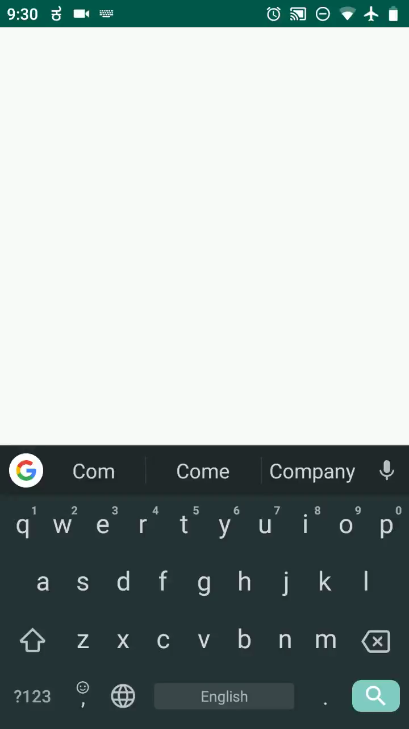
How to Manage States with Compose
Let’s build a statefull App
@rivuchakraborty
https://rivu.dev

Slide 79
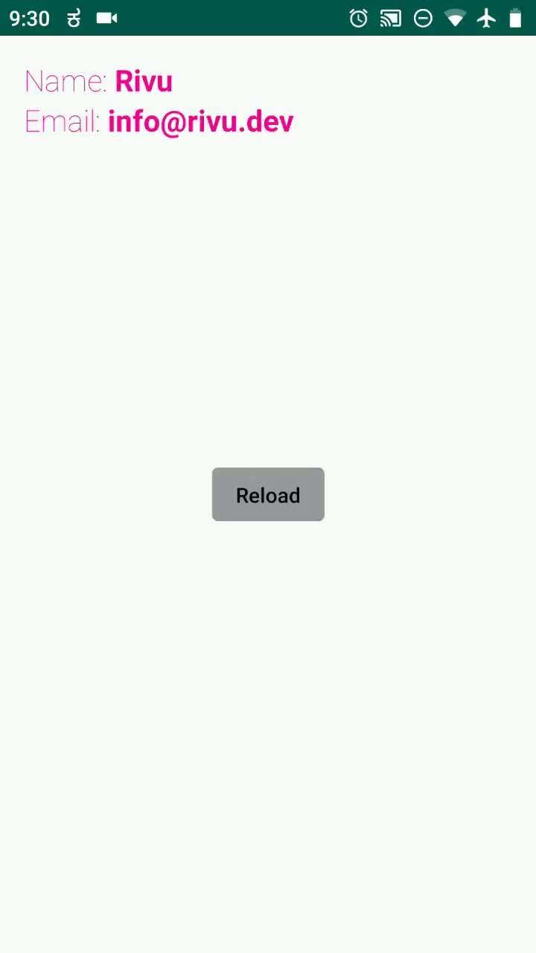
How to Manage States with Compose
data class User(
var name: String="",
var email: String=""
)
@rivuchakraborty
https://rivu.dev

Slide 80
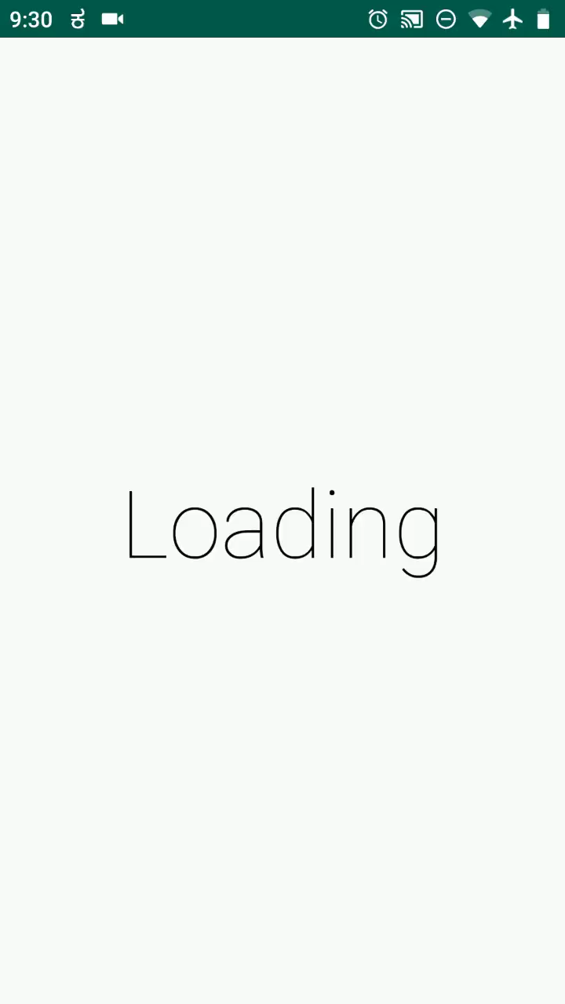
How to Manage States with Compose
sealed class UserViewState {
object Loading: UserViewState()
data class Success(
val user: User
): UserViewState()
data class Failure(
val errorDetails: String
): UserViewState()
}
@rivuchakraborty
https://rivu.dev

Slide 81
How to Manage States with Compose
class UserViewModel: BaseViewModel<UserIntents,
UserViewState, UserActions, UserResults> {
override fun states(): LiveData<UserViewState>
}
@rivuchakraborty
https://rivu.dev

Slide 82
How to Manage States with Compose
interface Presenter {
fun getUserAsync(): Observable<UserViewState>
}
@rivuchakraborty
https://rivu.dev

Slide 83
How to Manage States with Compose
UI
@rivuchakraborty
https://rivu.dev

Slide 84
How to Manage States with Compose
Success
@Composable
fun Body(user: User, onReloadClick: () -> Unit) {
Padding(padding = 16.dp) {
Column {
Row {
Text {
Span(text = "Name: ",style = +themeTextStyle { body1 })
Span(text = user.name, style = +themeTextStyle { h6 })
}
}
Row {
Text {
Span(text = "Email: ",style = +themeTextStyle { body1 })
Span(text = user.email, style = +themeTextStyle { h6 })
}
}
}
}
Align(Alignment.Center) {
ReloadButton(onReloadClick)
}
}
@rivuchakraborty
https://rivu.dev

Slide 85
@Composable
fun Body(user: User, onReloadClick: () -> Unit) {
Padding(padding = 16.dp) {
Column {
Row {
Text {
Span(text = "Name: ",style = +themeTextStyle { body1 })
Span(text = user.name, style = +themeTextStyle { h6 })
}
}
Row {
Text {
Span(text = "Email: ",style = +themeTextStyle { body1 })
Span(text = user.email, style = +themeTextStyle { body1 })
}
}
}
}
Align(Alignment.Center) {
ReloadButton(onReloadClick)
}
}
How to Manage States with Compose
Success
@rivuchakraborty
https://rivu.dev

Slide 86
@Composable
fun Body(user: User, onReloadClick: () -> Unit) {
Padding(padding = 16.dp) {
Column {
Row {
Text {
Span(text = "Name: ",style = +themeTextStyle { body1 })
Span(text = user.name, style = +themeTextStyle { h6 })
}
}
Row {
Text {
Span(text = "Email: ",style = +themeTextStyle { body1 })
Span(text = user.email, style = +themeTextStyle { body1 })
}
}
}
}
Align(Alignment.Center) {
ReloadButton(onReloadClick)
}
}
How to Manage States with Compose
Success
@rivuchakraborty
https://rivu.dev

Slide 87
How to Manage States with Compose
Success
@Composable
fun Body(user: User, onReloadClick: () -> Unit) {
Padding(padding = 16.dp) {
Column {
Row {
Text {
Span(text = "Name: ",style = +themeTextStyle { body1 })
Span(text = user.name, style = +themeTextStyle { h6 })
}
}
Row {
Text {
Span(text = "Email: ",style = +themeTextStyle { body1 })
Span(text = user.email, style = +themeTextStyle { h6 })
}
}
}
}
Align(Alignment.Center) {
ReloadButton(onReloadClick)
}
}
@rivuchakraborty
https://rivu.dev

Slide 88
How to Manage States with Compose
Error
@Composable
fun ErrorBody(onReloadClick: () -> Unit) {
Align(Alignment.Center) {
Column {
Row {
Text(text = "Load failed", style = +themeTextStyle { body1 })
}
Row {
ReloadButton(onReloadClick)
}
}
}
}
@rivuchakraborty
https://rivu.dev

Slide 89
How to Manage States with Compose
@Composable
fun ReloadButton(onReloadClick: () -> Unit) {
Button(onClick = onReloadClick,
text = "Reload",
color = +themeColor { lightGray })
}
Reload Button
@rivuchakraborty
https://rivu.dev

Slide 90
How to Manage States with Compose
sealed class UserViewState {
object Loading: UserViewState()
data class Success(
val user: User
): UserViewState()
data class Failure(
val errorDetails: String
): UserViewState()
}
@rivuchakraborty
https://rivu.dev

Slide 91
How to Manage States with Compose
sealed class UserViewState {
object Loading: UserViewState()
data class Success(
val user: User
): UserViewState()
data class Failure(
val errorDetails: String
): UserViewState()
}
State change In the UI Level
2 ways
@rivuchakraborty
https://rivu.dev

Slide 92
How to Manage States with Compose
Activity
class StateExampleActivity : Activity() {
@Inject
lateinit var presenter: Presenter
override fun onCreate(savedInstanceState: Bundle?) {
super.onCreate(savedInstanceState)
setContent {
CraneWrapper {
CustomTheme {
StateComposable(presenter)
}
}
}
}
}
Approach 1
@rivuchakraborty
https://rivu.dev

Slide 93
How to Manage States with Compose
Activity
class StateExampleActivity : Activity() {
@Inject
lateinit var presenter: Presenter
override fun onCreate(savedInstanceState: Bundle?) {
super.onCreate(savedInstanceState)
setContent {
CraneWrapper {
CustomTheme {
StateComposable(presenter)
}
}
}
}
}
Approach 1
@rivuchakraborty
https://rivu.dev

Slide 94
class StateExampleActivity : Activity() {
@Inject
lateinit var presenter: Presenter
override fun onCreate(savedInstanceState: Bundle?) {
super.onCreate(savedInstanceState)
setContent {
CraneWrapper {
CustomTheme {
StateComposable(presenter)
}
}
}
}
}
Activity
Approach 1
@rivuchakraborty
https://rivu.dev

Slide 95
Root Composable
How to Manage States with Compose
@Composable
fun StateComposable(
presenter: Presenter,
stateModel: UserViewState = UserViewState.Loading
) {
val data = +state { stateModel }
fun onReloadClick() {
data.value = UserViewState.Loading
}
when (stateModel) {
is UserViewState.Loading -> {
+onCommit {
presenter.getUserAsync()
.subscribe { userViewState ->
data.value = userViewState
}
}
Align(Alignment.Center) {
Text(text = "Loading", style = +themeTextStyle { h2 })
}
return
}
is UserViewState.Failure -> ErrorBody(::onReloadClick)
is UserViewState.Success -> {
val user = stateModel.user
Body(user, ::onReloadClick)
}
}
}
Approach 1
@rivuchakraborty
https://rivu.dev

Slide 96
@Composable
fun StateComposable(
presenter: Presenter,
stateModel: UserViewState = UserViewState.Loading
) {
val data = +state { stateModel }
fun onReloadClick() {
data.value = UserViewState.Loading
}
when (stateModel) {
is UserViewState.Loading -> {
+onCommit {
presenter.getUserAsync()
.subscribe { userViewState ->
data.value = userViewState
}
}
Align(Alignment.Center) {
Text(text = "Loading", style = +themeTextStyle { h2 })
}
return
}
is UserViewState.Failure -> ErrorBody(::onReloadClick)
is UserViewState.Success -> {
val user = stateModel.user
Body(user, ::onReloadClick)
}
}
}
Root Composable
Approach 1
@rivuchakraborty
https://rivu.dev

Slide 97
@Composable
fun StateComposable(
presenter: Presenter,
stateModel: UserViewState = UserViewState.Loading
) {
val data = +state { stateModel }
fun onReloadClick() {
data.value = UserViewState.Loading
}
when (stateModel) {
is UserViewState.Loading -> {
+onCommit {
presenter.getUserAsync()
.subscribe { userViewState ->
data.value = userViewState
}
}
Align(Alignment.Center) {
Text(text = "Loading", style = +themeTextStyle { h2 })
}
return
}
is UserViewState.Failure -> ErrorBody(::onReloadClick)
is UserViewState.Success -> {
val user = stateModel.user
Body(user, ::onReloadClick)
}
}
}
Root Composable
Approach 1
@rivuchakraborty
https://rivu.dev

Slide 98
@Composable
fun StateComposable(
presenter: Presenter,
stateModel: UserViewState = UserViewState.Loading
) {
val data = +state { stateModel }
fun onReloadClick() {
data.value = UserViewState.Loading
}
when (stateModel) {
is UserViewState.Loading -> {
+onCommit {
presenter.getUserAsync()
.subscribe { userViewState ->
data.value = userViewState
}
}
Align(Alignment.Center) {
Text(text = "Loading", style = +themeTextStyle { h2 })
}
return
}
is UserViewState.Failure -> ErrorBody(::onReloadClick)
is UserViewState.Success -> {
val user = stateModel.user
Body(user, ::onReloadClick)
}
}
}
Root Composable
Approach 1
@rivuchakraborty
https://rivu.dev

Slide 99
How to Manage States with Compose
@Model
class ViewStateModel(
var user: User? = null,
var error: String = "",
var isLoading: Boolean = false
)
Model Class
Approach 2
@rivuchakraborty
https://rivu.dev

Slide 100
How to Manage States with Compose
Activity
class ModelClassExampleActivity : Activity() {
var stateModel = ViewStateModel(isLoading = true)
@Inject
lateinit var presenter: Presenter
val compositeDisposable = CompositeDisposable()
override fun onCreate(savedInstanceState: Bundle?) {
super.onCreate(savedInstanceState)
setContent {
CraneWrapper {
CustomTheme {
ModelComposable(stateModel,::loadData)
}
}
}
loadData()
}
private fun loadData() {
stateModel.isLoading = true
val disposable = presenter.getUserAsync()
.subscribe {
when (it) {
is UserViewState.Loading ->
stateModel.isLoading = true
is UserViewState.Failure ->
stateModel.error = it.errorDetails
is UserViewState.Success ->
stateModel.user = it.user
}
}
compositeDisposable.add(disposable)
}
override fun onDestroy() {
super.onDestroy()
compositeDisposable.dispose()
}
}
Approach 2
@rivuchakraborty
https://rivu.dev

Slide 101
class ModelClassExampleActivity : Activity() {
var stateModel = ViewStateModel(isLoading = true)
@Inject
lateinit var presenter: Presenter
val compositeDisposable = CompositeDisposable()
override fun onCreate(savedInstanceState: Bundle?) {
super.onCreate(savedInstanceState)
setContent {
CraneWrapper {
CustomTheme {
ModelComposable(stateModel,::loadData)
}
}
}
loadData()
}
private fun loadData() {
stateModel.isLoading = true
val disposable = presenter.getUserAsync()
.subscribe {
when (it) {
is UserViewState.Loading ->
stateModel.isLoading = true
is UserViewState.Failure ->
stateModel.error = it.errorDetails
is UserViewState.Success ->
stateModel.user = it.user
}
}
compositeDisposable.add(disposable)
}
override fun onDestroy() {
super.onDestroy()
compositeDisposable.dispose()
}
}
Activity
Approach 2
@rivuchakraborty
https://rivu.dev

Slide 102
class ModelClassExampleActivity : Activity() {
var stateModel = ViewStateModel(isLoading = true)
@Inject
lateinit var presenter: Presenter
val compositeDisposable = CompositeDisposable()
override fun onCreate(savedInstanceState: Bundle?) {
super.onCreate(savedInstanceState)
setContent {
CraneWrapper {
CustomTheme {
ModelComposable(stateModel,::loadData)
}
}
}
loadData()
}
private fun loadData() {
stateModel.isLoading = true
val disposable = presenter.getUserAsync()
.subscribe {
when (it) {
is UserViewState.Loading ->
stateModel.isLoading = true
is UserViewState.Failure ->
stateModel.error = it.errorDetails
is UserViewState.Success ->
stateModel.user = it.user
}
}
compositeDisposable.add(disposable)
}
override fun onDestroy() {
super.onDestroy()
compositeDisposable.dispose()
}
}
Activity
Approach 2
@rivuchakraborty
https://rivu.dev

Slide 103
class ModelClassExampleActivity : Activity() {
var stateModel = ViewStateModel(isLoading = true)
@Inject
lateinit var presenter: Presenter
val compositeDisposable = CompositeDisposable()
override fun onCreate(savedInstanceState: Bundle?) {
super.onCreate(savedInstanceState)
setContent {
CraneWrapper {
CustomTheme {
ModelComposable(stateModel,::loadData)
}
}
}
loadData()
}
private fun loadData() {
stateModel.isLoading = true
val disposable = presenter.getUserAsync()
.subscribe {
when (it) {
is UserViewState.Loading ->
stateModel.isLoading = true
is UserViewState.Failure ->
stateModel.error = it.errorDetails
is UserViewState.Success ->
stateModel.user = it.user
}
}
compositeDisposable.add(disposable)
}
override fun onDestroy() {
super.onDestroy()
compositeDisposable.dispose()
}
}
Activity
Approach 2
@rivuchakraborty
https://rivu.dev

Slide 104
How to Manage States with Compose
@Composable
fun ModelComposable(viewStateModel: ViewStateModel,
onReloadClick: () -> Unit) {
val user = viewStateModel.user
if(viewStateModel.isLoading) {
Align(Alignment.Center) {
Text(text = "Loading", style = +themeTextStyle { h2 })
}
} else if(viewStateModel.error.isNotBlank() || user == null) {
ErrorBody(onReloadClick)
} else {
Body(user, onReloadClick)
}
}
Composable
Approach 2
@rivuchakraborty
https://rivu.dev

Slide 105
@Composable
fun ModelComposable(viewStateModel: ViewStateModel,
onReloadClick: () -> Unit) {
val user = viewStateModel.user
if(viewStateModel.isLoading) {
Align(Alignment.Center) {
Text(text = "Loading", style = +themeTextStyle { h2 })
}
} else if(viewStateModel.error.isNotBlank() || user == null) {
ErrorBody(onReloadClick)
} else {
Body(user, onReloadClick)
}
}
@rivuchakraborty
https://rivu.dev

Slide 106
Let’s Talk Composing UI Take Aways
Try out Jetpack Compose
Play with +state, +model
Try @Model class
Try using your preferred Architecture Pattern with Jetpack Compose
@rivuchakraborty
https://rivu.dev

Slide 107
Let’s Talk Composing UI Resources
https://developer.android.com/jetpack/compose
http://bit.ly/composefirstprinciple
http://bit.ly/contentondeclarativeUI
https://speakerdeck.com/lelandrichardson/react-meet-compose
https://rivu.dev/writing-android-ui-code-in-jetpack-compose/
https://rivu.dev/jetpack-compose-managing-states/
https://fragmentedpodcast.com/episodes/172/
@rivuchakraborty
https://rivu.dev

Slide 108
Slide Design by instagram.com/mohijeet/
धन्यवाद!!
Thank You!!
@rivuchakraborty
https://rivu.dev

